Slide 1
Priming/ Agent Setting(M/S 237)
Agent Setting: Mass media influencing what we think and worry about by making a topic seem more or less important than it actually is. News channels will focus on what they think is important or will get them viewers, which in turn, makes what we see seem important.
Priming: is the process where the media may develop or change someone's opinion of something. Such as what a “good” or “bad” person looks like.

Slide 2
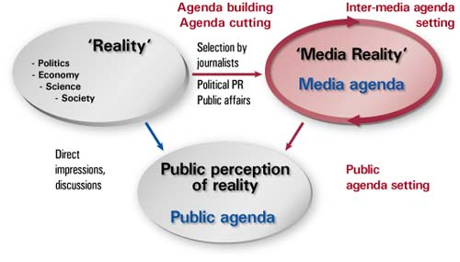
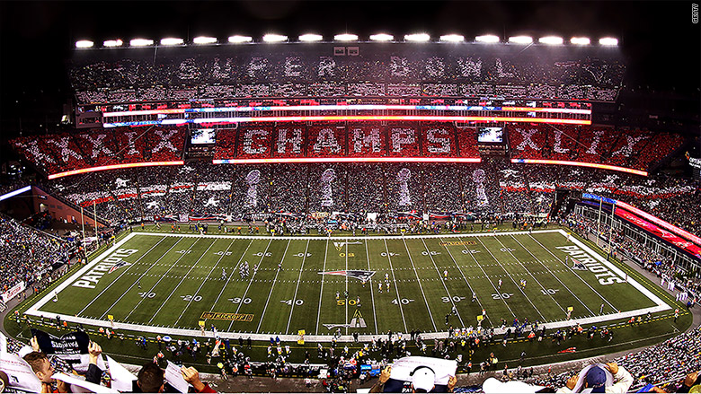
Examples
Notes:
Agenda-Setting
Premise: Media do not tell us what to think, but rather what to think about.
Example: In political campaigns, the media may not be effective in swaying public support toward or against a particular issue or candidate. But by continually raising particular questions and issues, or simply by showing an interest in a particular political candidate or issue, the media can lead the discussion toward or away from issues important to the candidate and even to the public (as identified through polls).
Priming
Premise: Media provide a context for public discussion of an issue, setting the stage for audience understanding.
Example: Media reporting may be very strong leading up to an event such as the Olympics, Super Bowl, or World Cup, making it almost impossible for audiences to ignore the event. Such aggressive reporting thus creates an audience of people at least temporarily interested in the sport, even though prior to the reporting many (perhaps most) members of the audience were not sports fans. Rather, they are people who get caught up in the moment.

Slide 3
Why is it important?
Understanding Priming and Agent Setting is very important in media studies. It is important to know how the media uses agent setting to influence the “importance” of an issue. Being aware of this strategy will remind you that there may be bigger topics that you may want to gain knowledge on other than the stories the main media outlets feel they will get the most viewers on, and are providing. Being aware of priming is important in a media studies class because knowing how the media can change someone's opinion of something by what they show, or fail to show may influence how you receive the information that the media gives you.

Slide 4
Definition:
https://study.com/academy/lesson/agenda-setting-definition-function-process-examples.html
Example:
https://www.youtube.com/watch?v=5N9AfcY91jg

