Slide 1
Culture Industry
Stine Pontoppidan Bjørkbom

Slide 2
Culture Industry
Adorno/Horkheimer
The Culture Industry is a culture made of standardization of cultural items as film, radio, and art. It is a culture that encourage people to buy products, we think fits our needs and demands. The culture industry makes a society consistent of mass culture instead of encouraging freedom and individuality because companies profit is valued over consumer well-being

Slide 3
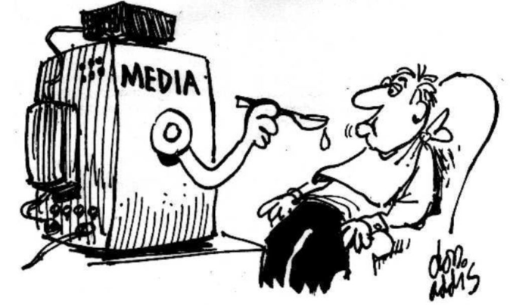
https://www.youtube.com/watch?v=VlblkynmPoo 1:00

