Slide 1
Model Minority
Definition
Group of individuals from a minority demographic who excel above the economic and social standards that are typical of that demographic, and are categorized falsely as a representation of the whole
Importance
Individuals both within and outside the model minority are stereotyped by the majority, who use inferential racism to categorize minorities rather than explicit racism
Affirms commitment to equality and generalizes individuals, shifting the blame to those who contradict the model minority

Slide 2
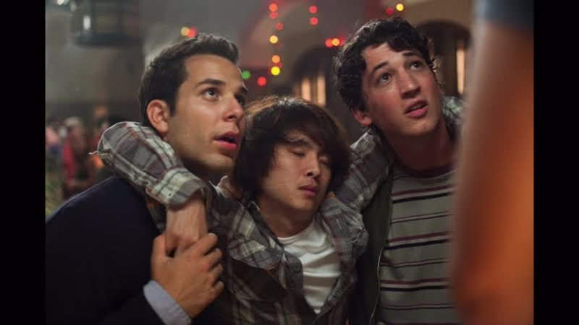
Examples: Get Out and 21 and Over - Asian Americans
https://www.youtube.com/watch?v=UnGv24CFxK4
https://www.themarysue.com/model-minority-get-out/

