Slide 1
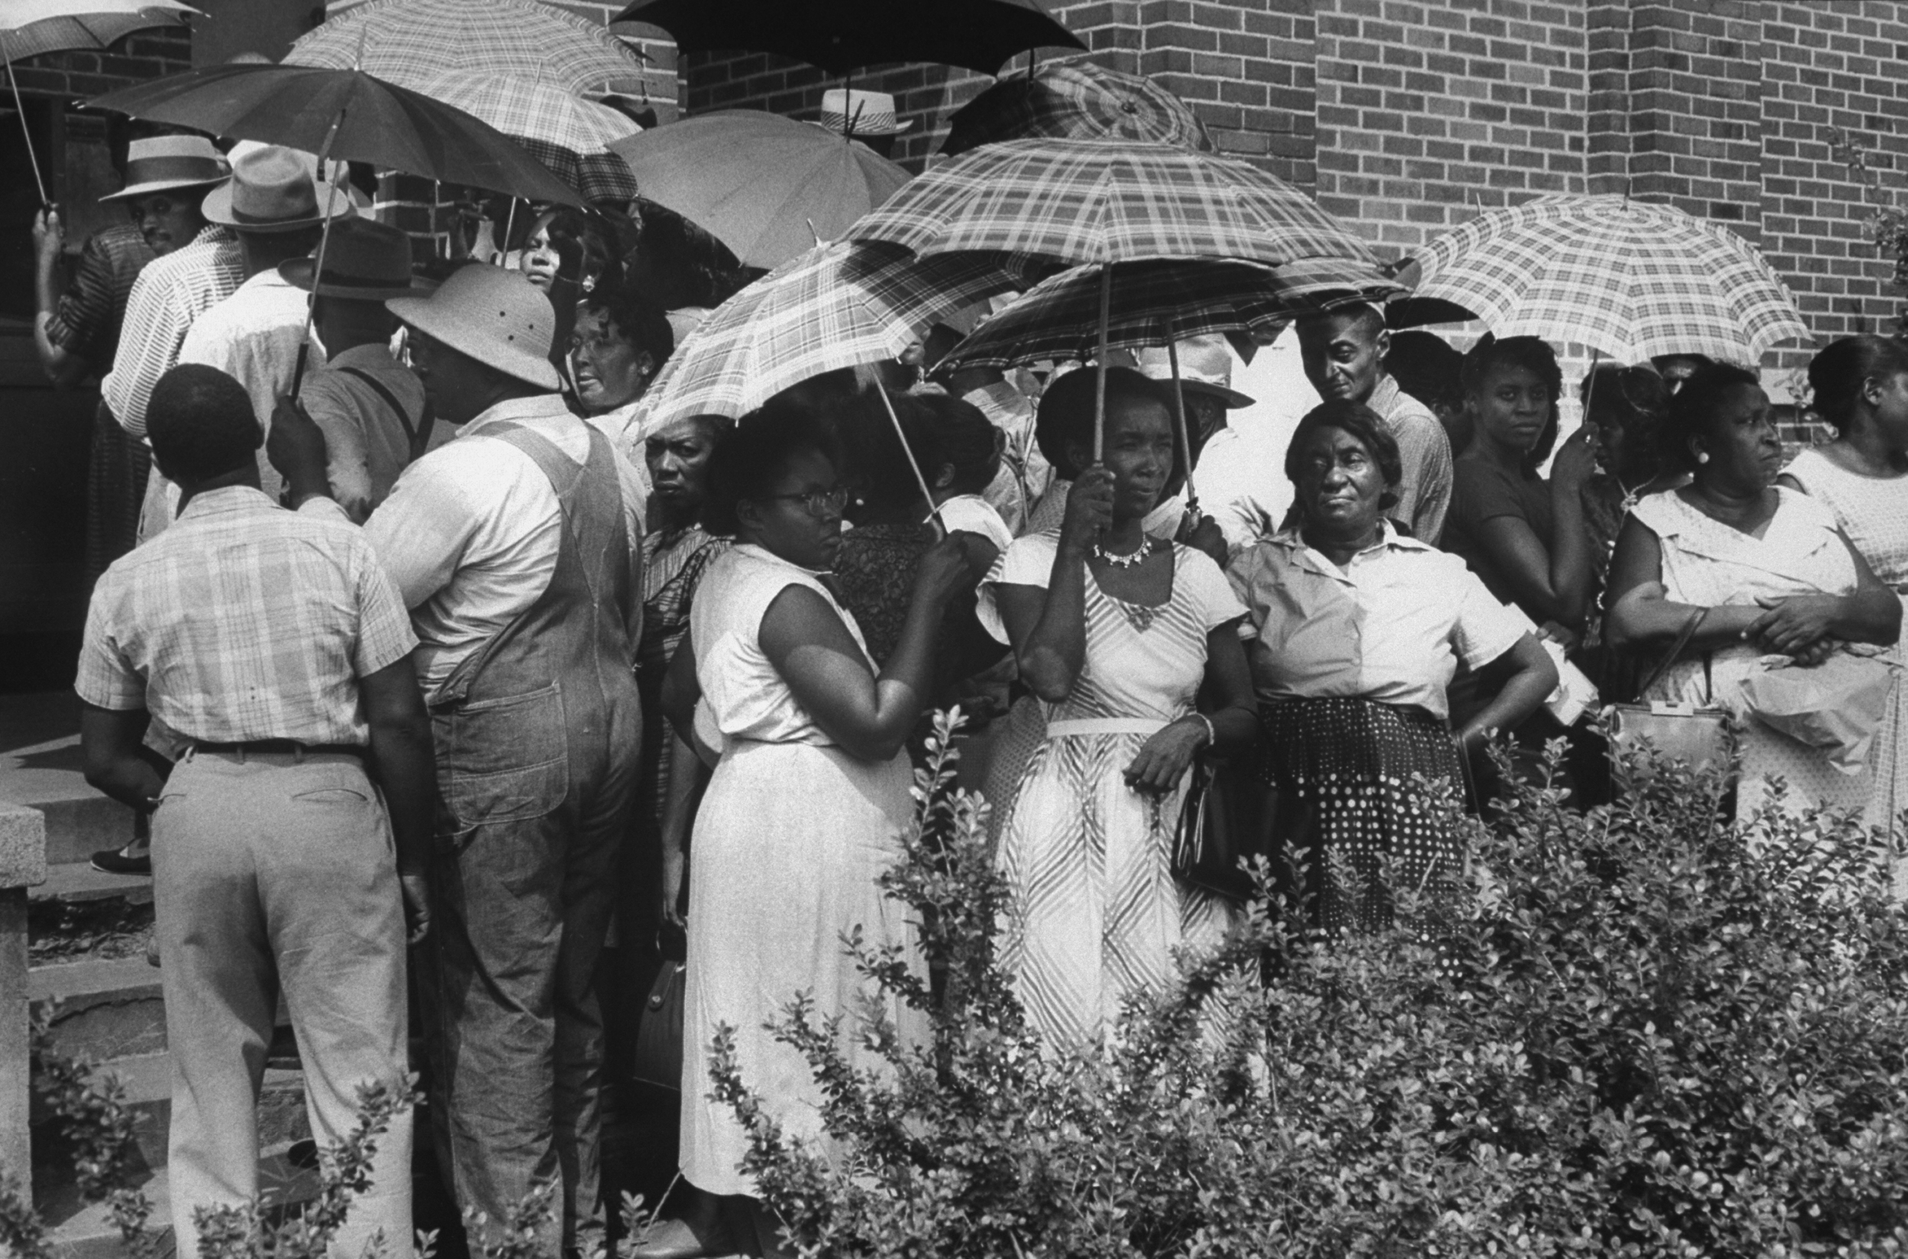
Democracy and American Politics
Notes:
The right to vote in elections is fundamental to democracy. But many Americans won the right to vote only after long struggles. It took more than 30 years from the adoption of the Constitution for most states to allow white men without property to vote. Women gained the right to vote in all U.S. elections only in 1920, and young people ages 18 to 20 did so only beginning in 1971. Not many African Americans in the South were able to vote until after 1965.

Slide 2
What is a democracy?
Does government work?

Slide 3
1.1
Democracy
Democratic Origins
Direct Versus Representative Democracy
Benchmarks of Representative Democracy
Objections to Liberal Democracy
© 2015 Pearson Education, Inc. All rights reserved.
Notes:
Democracy is a system of rule by the people, rooted in three fundamental principles:
• popular sovereignty
• political equality
• political liberty
In a representative democracy like that of the United States, the people don’t rule directly, but through elected representatives. People have broad civil and political rights, but the majority doesn’t always get its way. Because democracy holds an important place in Americans’ values and is particularly relevant to judging political processes, it’s the standard we’ll use throughout this course to evaluate the quality of our politics and government.

Slide 4
Benchmarks of Representative Democracy
1.1
Popular Sovereignty
Government leaders are selected in competitive elections
Elections are free and fair
People participate in the political process
High-quality information is available
© 2015 Pearson Education, Inc. All rights reserved.
Notes:
Popular sovereignty means that people are the ultimate source of government authority and that what the government does is determined by what the people want. How can we recognize popular sovereignty when we see it?
Government leaders must be selected in competitive elections that are free and fair. By free, we mean that there’s no coercion of voters or election officials and that all adult citizens are able to run for office and vote in elections. By fair, we mean that election rules don’t favor some over others and that ballots are accurately counted. Widespread participation is necessary to keep elected officials responsive to the will of the people. If people are to form authentic and rational attitudes about public policies and political leaders, they must have access to accurate political information, insightful interpretations, and vigorous debate.

Slide 5
Benchmarks of Representative Democracy
1.1
Popular Sovereignty
Majority rules
Government policies reflect the wishes of the people
Government policies are effective
© 2015 Pearson Education, Inc. All rights reserved.
Notes:
If the actions of government are to respond to all citizens, the only decision rule that makes sense is majority rule. The most obvious sign of popular sovereignty is the existence of a close correspondence between what government does and what the people want it to do.
Additionally, these policies must be carried out as intended and must effectively address the problems that led to the formation of these policies in the first place. Without this last condition, the people might end up with policies in place that reflect their wishes in name only. Government policies must be turned into government actions that work.

Slide 6
1.1
Benchmarks of Representative Democracy
Political Equality
Equal protection
Civil rights
Linked to economic equality?
Political Liberty
Social contract
© 2015 Pearson Education, Inc. All rights reserved.
Notes:
The second benchmark of representative democracy, and a necessary condition for popular sovereignty to exist, is political equality. This is the idea that each person, being of equal intrinsic value as other human beings, carries the same weight in voting and other political decision making.
Political equality also involves what the Fourteenth Amendment to the Constitution calls “equal protection,” meaning that everyone in a democracy is treated the same by government. Taken together, political equality and equal treatment are sometimes called civil rights. Is political equality possible when great economic inequality exists, as is the case in the United States?
A third benchmark of democracy in representative systems, and another necessary condition for popular sovereignty to exist, is political liberty. Political liberty refers to basic freedoms essential to the formation and expression of majority opinion and its translation into public policies. These essential liberties include the freedoms of speech, of conscience and religion, of the press, and of assembly and association, embodied in the First Amendment to the U.S. Constitution.
Philosopher John Locke thought that individual rights and liberty were so fundamental to society that their protection is the very reason people agreed to enter into a social contract to form a government in the first place.

Slide 7
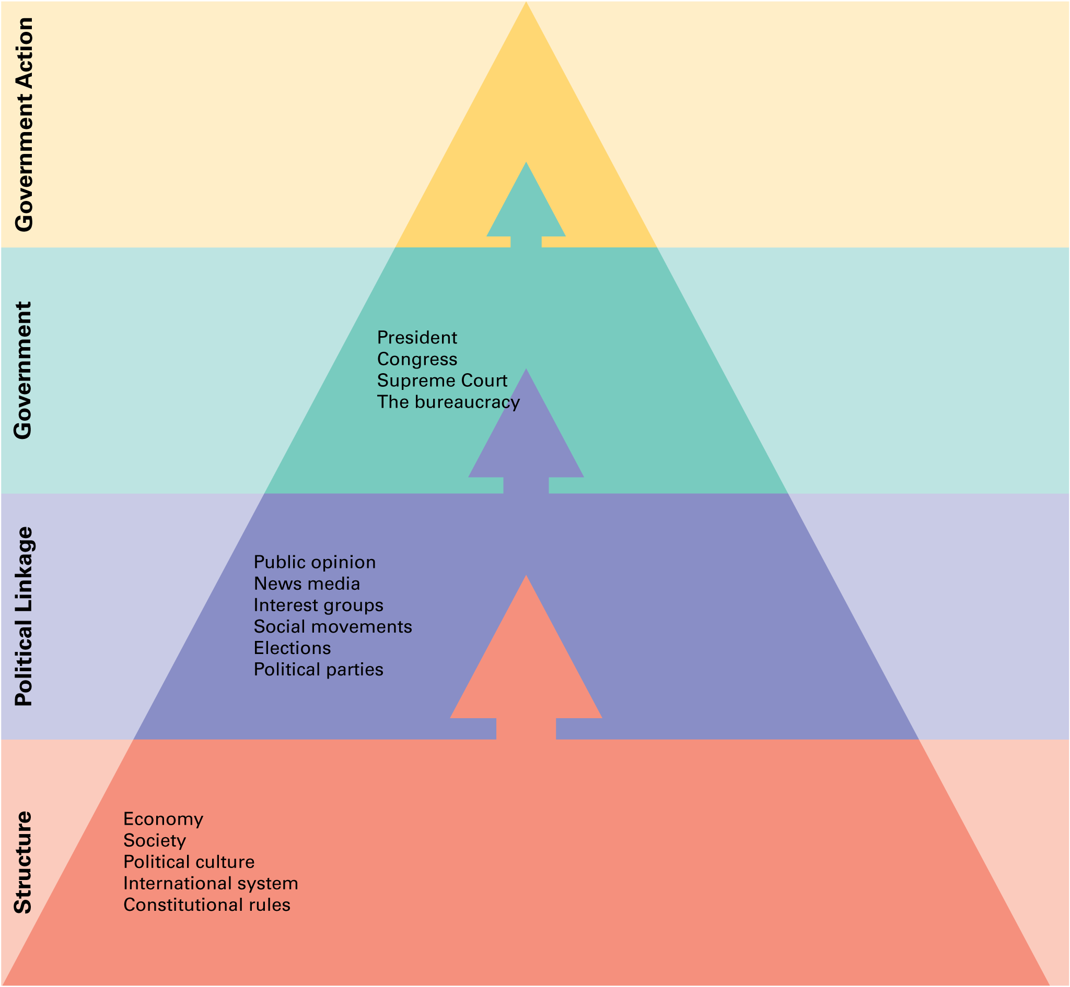
FIGURE 1.1: The analytical framework
1.2
Notes:
Various actors, institutions, and processes interact to influence what government does in the United States. Structural factors such as the economy, the political culture, the international system, and constitutional rules play a strong role in political events. They may influence the government directly, or, as is more often the case, through political linkages such as elections, parties, and interest groups. In a democratic society, government policies should reflect these influences.

