Slide 1
The Constitution
Notes:
In the Constitution, the framers designed a framework for a government of separated powers and checks and balances. They divided executive, legislative, and judicial powers and placed them into separate branches of the national government. They also gave each branch an important role in the affairs of the other branches to prevent any branch from becoming too powerful.
As you might suspect, a system of separation of powers and checks and balances is rife with potential conflict among the branches. It has been so since the beginning of the Republic. It is exactly the sort of thing the framers had in mind. This chapter is about the constitutional design of the American government, why the framers fashioned the sort of constitution they did, how the Constitution shapes political life and government actions in the United States, and how the meaning of the Constitution has changed over the years.

Slide 2
2
Learning Objectives
Assess the enduring legacies of the American Revolution and the Declaration of Independence
Describe the governmental system established by our first constitution
Analyze the issues that led to the Constitutional Convention
Evaluate the framework that emerged from the Constitutional Convention
© 2015 Pearson Education, Inc. All rights reserved.
Notes:
The learning objectives provide a brief overview of the key topics. In this chapter we will discuss how the new government at the end of the American Revolution was set up according to the Articles of Confederation.
We'll see why the Articles were unsatisfactory and created problems. The Framers tried to resolve these problems and considered all of them in their initial framing of the Constitution.
We'll also see how early Americans did not fully embrace the Constitution, and its ratification was no sure thing. Anti-Federalists fought hard to retain the individual liberties that they thought the Constitution denied them.
Finally, we'll discuss the complex process of Constitutional amendments and the various paths to changing the laws of the land.

Slide 3
2
Learning Objectives, cont.
Explain the difficulties of ratifying the Constitution
Identify three processes by which the Constitution changes
© 2015 Pearson Education, Inc. All rights reserved.
Notes:
The learning objectives provide a brief overview of the key topics. In this chapter we will discuss how the new government at the end of the American Revolution was set up according to the Articles of Confederation.
We'll see why the Articles were unsatisfactory and created problems. The Framers tried to resolve these problems and considered all of them in their initial framing of the Constitution.
We'll also see how early Americans did not fully embrace the Constitution, and its ratification was no sure thing. Anti-Federalists fought hard to retain the individual liberties that they thought the Constitution denied them.
Finally, we'll discuss the complex process of Constitutional amendments and the various paths to changing the laws of the land.

Slide 4
Key Ideas in the Declaration of Independence
“We hold these truths to be self-evident, that all men are created equal, that they are endowed by their Creator with certain unalienable Rights, that among these are Life, Liberty, and the Pursuit of Happiness.”
Social contract
Notes:
The ideas in the Declaration of Independence are familiar now. But at the time that it was written, the words in the document were revolutionary.
European monarchs supposedly got their authority from God. However, John Locke wrote in his Second Treatise on Government that the right to govern came from the people. Jefferson followed Locke’s ideas closely when he said that a government should protect people’s inalienable rights and needed to have the consent of the people to govern. At the time, these ideas seemed outrageous.
Jefferson justified the colonists’ bid for independence by declaring that if a government fails to protect people’s rights or itself becomes a threat to them, people can withdraw their consent from that government and form a new one.

Slide 5
Provisions of the Articles
Weak central government
Decisions made in state legislatures
No power to levy taxes
No power to regulate commerce
No chief executive
No judicial system
Required unanimous approval to amend
Notes:
The leaders of the American Revolution set up a loose confederation of states, not a strong, centralized government. Most Americans in the late eighteenth century believed that only a small republic made up of inhabitants with the same goals and values as their own could govern by popular consent and protect their rights. It just didn’t seem possible that colonies so widely spread out, and with such different ways of life and economic interests could make up a unified republic. The Articles of Confederation gave little power to the central government. Under the Articles, most important decisions were made in state legislatures.
Congress had no power to levy taxes. It could not regulate commerce among the states. It couldn’t deny the states the right to collect customs duties. It had no independent chief executive to ensure that the laws passed by Congress would be enforced, and it had no national court system to settle disputes among the states. There were no means to provide a sound national money system.
Problems with the new constitution were hard to fix because amending the Articles required the unanimous approval of the states.

Slide 6
Shortcomings of the Articles
No way to generate revenue
No unified stance in foreign affairs
WEAK central government
No power to regulate commerce
Interstate tariffs stifled economic growth
Notes:
The Articles preserved the sovereignty of the states, but the weak central government quickly proved to be a problem. The government was also unable to prevent the outbreak of commercial warfare among the states. As virtually independent nations with the power to levy customs duties, many states became intense commercial rivals. This situation was an obstacle to the expansion of commercial activities and economic growth.

Slide 7
Eighteenth-Century Republican Beliefs of the Founders
Common people getting uppity
Republicanism
Elect government leaders
Limit power of government
Limit popular input
Representatives use judgment
Founders did not want an “excess” of democracy

Slide 8
Why the Founders Were Worried
Threats to property rights in the states
Stay acts
Shays’s Rebellion
Tyranny—of the majority and the minority
Representative Government-Elections
Narrow the franchise (not everyone could vote)
Limit the power of government
Notes:
Worries that untamed democracy was on the rise were not unfounded. Popular assemblies were created in several states to keep tabs on state legislatures and to issue instructions to legislatures concerning what bills to pass.
In 1786, judges in Massachusetts had ordered the seizure of farms when farmers could not afford to pay state taxes. When Massachusetts failed to take action to help its debt-ridden farmers, there was a rebellion. In 1786, Daniel Shays led farmers in a protest to prevent foreclosure hearings from taking place in state court. The rebellion was put down with the aid of private money and militias. It realized the worst fears of national leaders about the dangers of ineffective state governments and popular democracy unchecked by a strong national government. They called a meeting to revise the Articles but instead decided to scrap them and start fresh.
As we’ve seen, preventing tyranny was important to the Founders. Can you answer this question about ways they tried to keep tyranny out of American government?
The constitution of the state of Pennsylvania also offended republican principles. This constitution replaced the property qualification to vote with a small tax, created a one-house legislature whose members were elected annually, mandated that legislative deliberations be open to the public, and required that proposed legislation be publicized.

Slide 9
Who Were the Founders? Does it matter?
Wealthy
Educated
Experienced public officials
Revolutionary War veterans
No women or blacks, nor poor
Motivated to protect their economic interests
Success not guaranteed

Slide 10
Consensus and Conflict at the Convention
2.4
The Great Compromise
Virginia Plan
New Jersey Plan
Connecticut Compromise
Slavery-The framers give up and accept it.
The Electoral College—Why?
Decided on a Republican form of government
© 2015 Pearson Education, Inc. All rights reserved.
Notes:
The most intense disagreements at the convention concerned the issue of representation in Congress. The Virginia Plan, drafted by James Madison, proposed the creation of a strong central government dominated by a powerful bicameral Congress with numbers of seats given to the states on the basis of population size.
The smaller states countered with the New Jersey Plan, whose central feature was a unicameral national legislature whose seats were shared equally among the states. The New Jersey Plan asked for a slightly more powerful national government than under the Articles of Confederation, but one in which each of the states remained sovereign and equal.
The Great, or Connecticut, Compromise satisfied both large and small states. Its key feature was a bicameral legislature in which each state’s representation in the House of Representatives would be based on population, while representation in the Senate would be equal for all states.
The Constitution refers to slavery three times. First, the delegates agreed to count three-fifths of a state’s slave population for representation and tax purposes. Second, it forbade enactments against the slave trade until the year 1808. Third, it required non-slave states to return runaway slaves to their owners in slave states.
The framers feared the rule of the majority, so they set up the Electoral College to elect the president and gave the power to elect senators to the state legislatures.
In 1911, Senator Joseph Bristow from Kansas offered a resolution, proposing a constitutional amendment. The idea also enjoyed strong support from Senator William Borah of Idaho, himself a product of direct election. Eight southern senators and all Republican senators from New England, New York, and Pennsylvania opposed Senator Bristow's resolution. The Senate approved the resolution largely because of the senators who had been elected by state-initiated reforms, many of whom were serving their first term, and therefore may have been more willing to support direct election. After the Senate passed the amendment, which represented the culmination of decades of debate about the issue, the measure moved to the House of Representatives.
The House initially fared no better than the Senate in its early discussions of the proposed amendment. Much wrangling characterized the debates, but in the summer of 1912 the House finally passed the amendment and sent it to the states for ratification. The campaign for public support was aided by senators such as Borah and political scientist George H. Haynes, whose scholarly work on the Senate contributed greatly to passage of the amendment.
Connecticut's approval gave the Seventeenth Amendment the required three-fourths majority, and it was added to the Constitution in 1913. The following year marked the first time all senatorial elections were held by popular vote.
The Seventeenth Amendment restates the first paragraph of Article I, section 3 of the Constitution and provides for the election of senators by replacing the phrase "chosen by the Legislature thereof" with "elected by the people thereof." In addition, it allows the governor or executive authority of each state, if authorized by that state's legislature, to appoint a senator in the event of a vacancy, until a general election occurs.

Slide 11
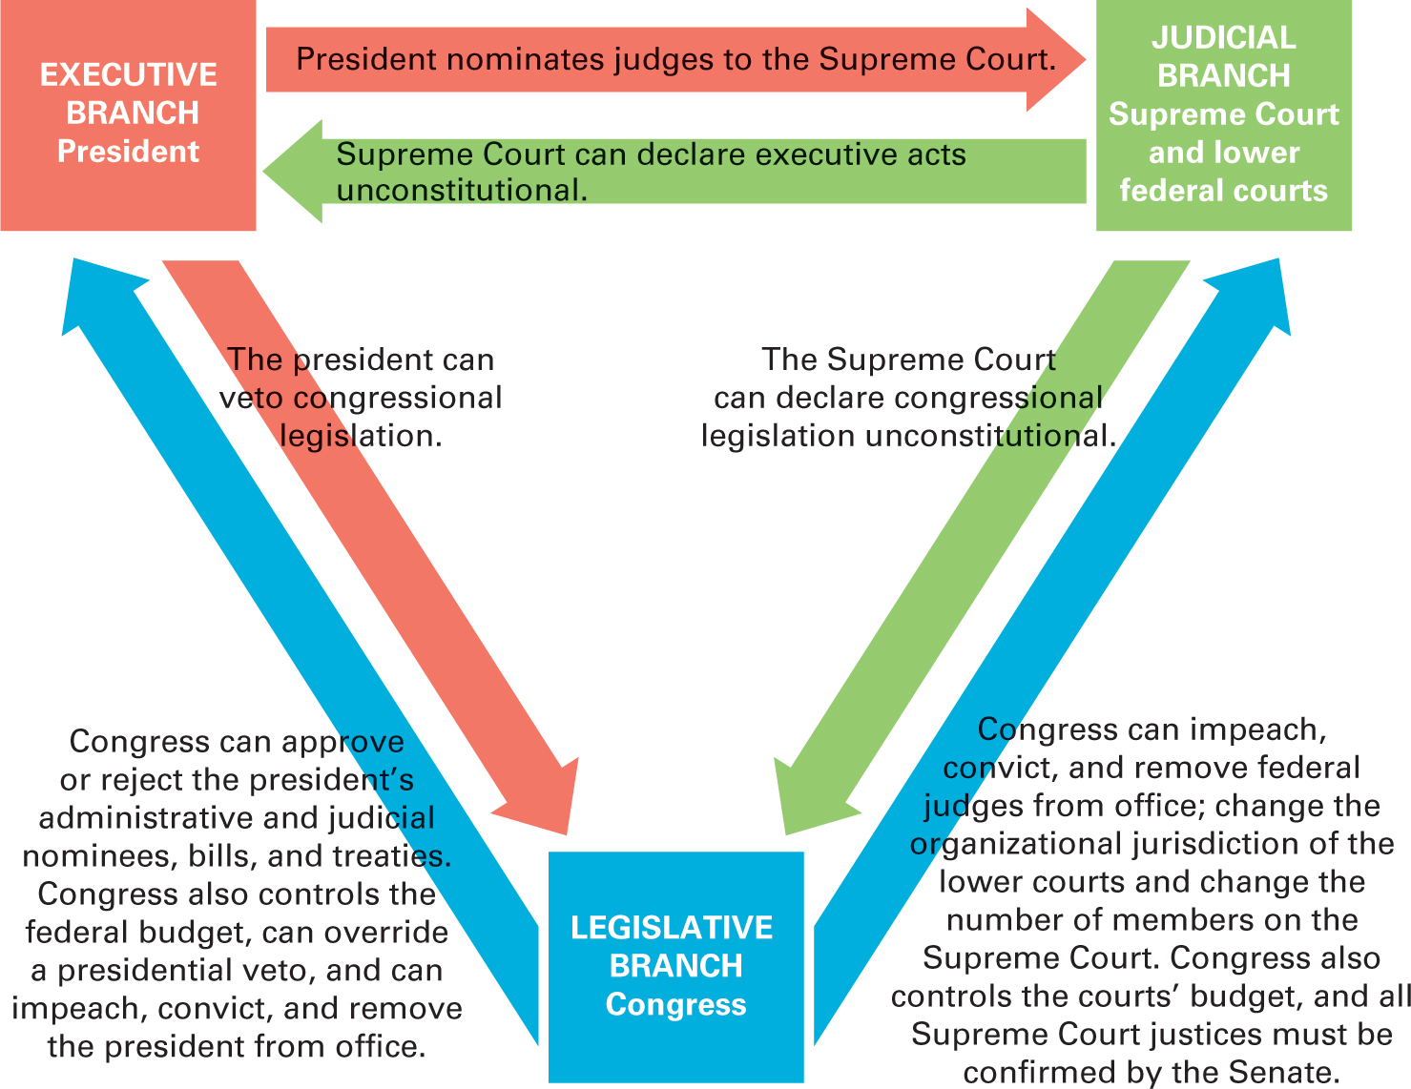
CHECKS AND BALANCES
Notes:
The framers of the Constitution believed that tyranny might be avoided by breaking down the power of government into its executive, legislative, and judicial parts, and by making each part the responsibility of a separate branch of government. To further protect against tyranny, they created mechanisms by which the actions of any single branch could be blocked by either or both of the other branches.

Slide 12
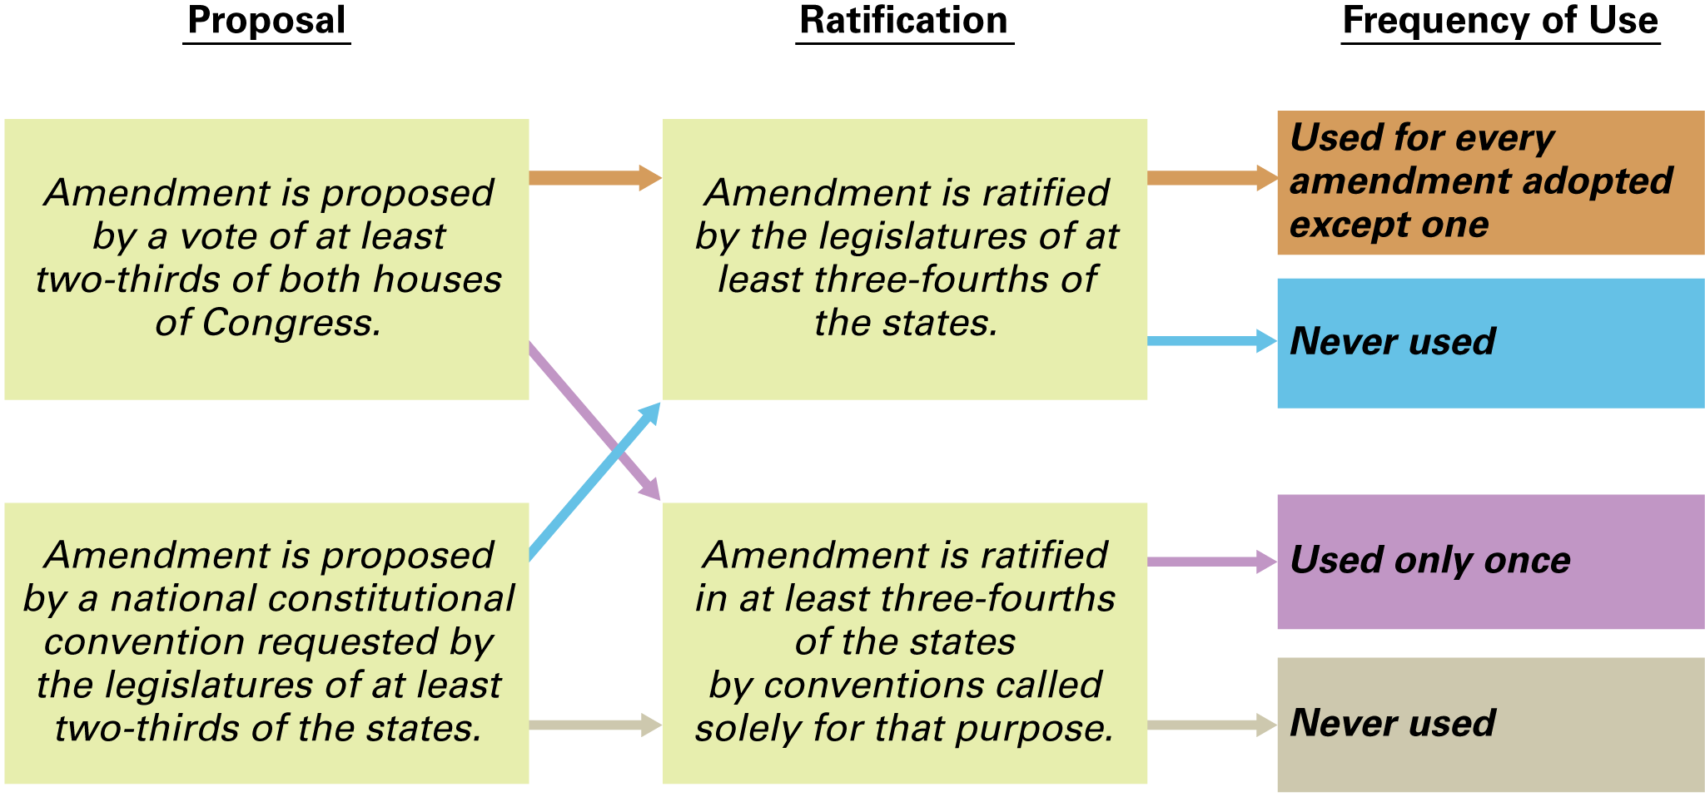
2.4
Amending the Constitution
© 2015 Pearson Education, Inc. All rights reserved.
Notes:
With two ways of proposing a constitutional amendment and two ways of ratifying one, there are four routes to changing the Constitution. In all but one case (the Twenty-First Amendment, which repealed Prohibition), constitutional amendments have been proposed by Congress and then ratified by the state legislatures.

Slide 13
Why It’s Hard to Change the Constitution
Ratification too hard
Supremes decide what is Constitutional
Fear of opening a “can of worms”
Fear of abrogation of the Bill of Rights

