Slide 1
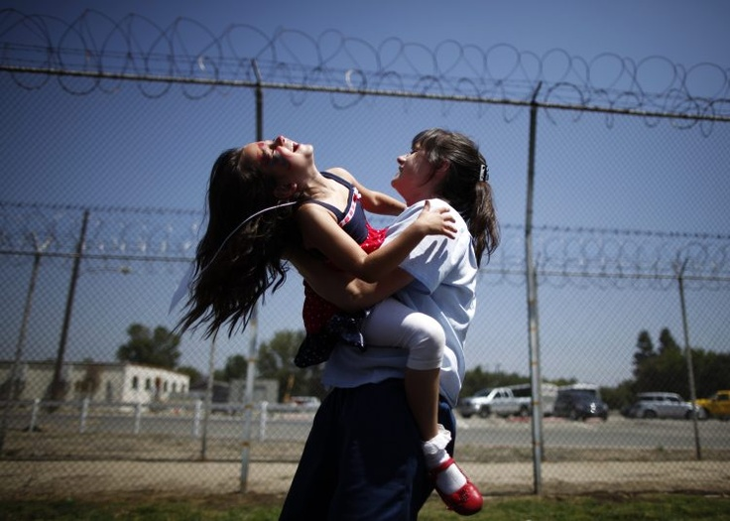
The Silent Victims
By Bailey Duplessie

Slide 2
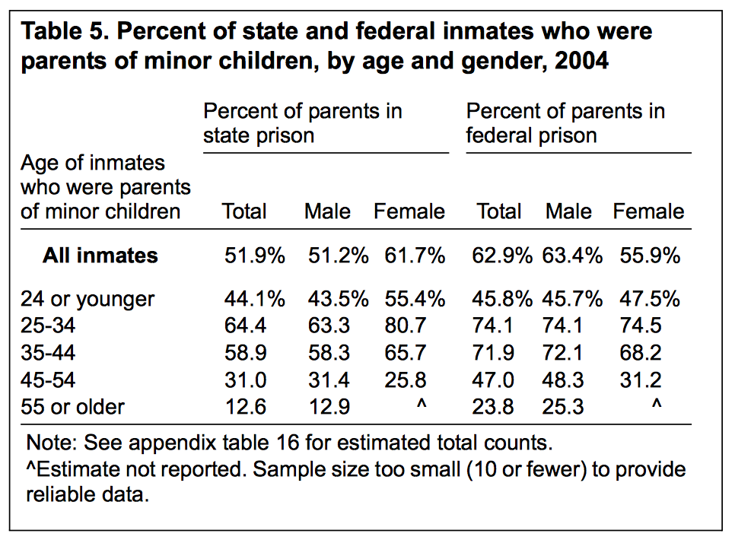
Statistics
Since 1991, the number of mothers in prison has more than doubled
4 in 10 mothers in state prison who had minor children were the sole parent in the household before arrest
70% of women prisoners are primary caregivers of the children before their arrest
Mothers more likely than fathers to report homelessness, physical or sexual abuse, and to have either a current medical or mental health problem.

Slide 3
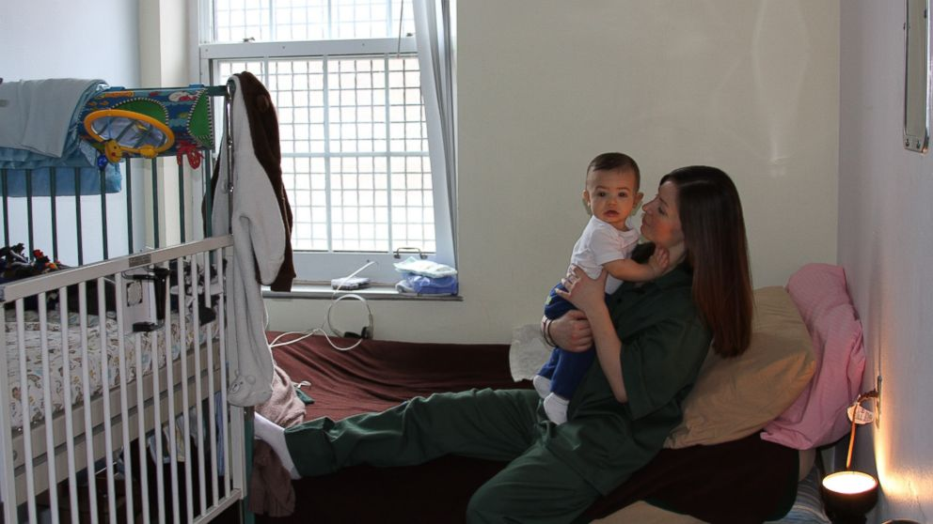
Children Born Behind Bars
http://abcnews.go.com/US/babies-born-raised-bars-mothers-returning-prison/story?id=22413184

Slide 4
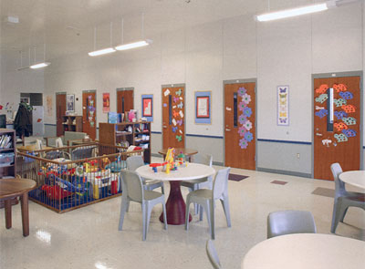
Raising a Child Behind Bars
Prison Nurseries
$24,000 a year to raise a child in jail
Many prisons after different programs
Bedford Hills Correctional Facility
Stay with mother till 1 year old
Given parenting courses
Offer vocational services, visiting services for older children
Nebraska Correctional Center for Women
Baby can stay with their mom till they are 18 months
Mom must take childbirth and parenting classes before and after the baby is born
Ohio Reformatory for Women
Can stay there till child is 18 months old
When the mom is busy there is a "nanny" who will take care fo the child - the nanny is another inmate who has been train

Slide 5
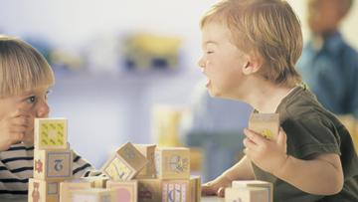
Behavioral Issues Study
"Behavior Problems and Competence in Preschoolers Who Spent Their First One to Eighteen Months in a Prison Nursery Program" by Lorie Goshin
47 children who had lived in a prison nursery and 60 children who were separated from their mother
30% of those who lived in a prison nursery and 47% who were separated from their mothers had at least one problem in the clinical range

Slide 6
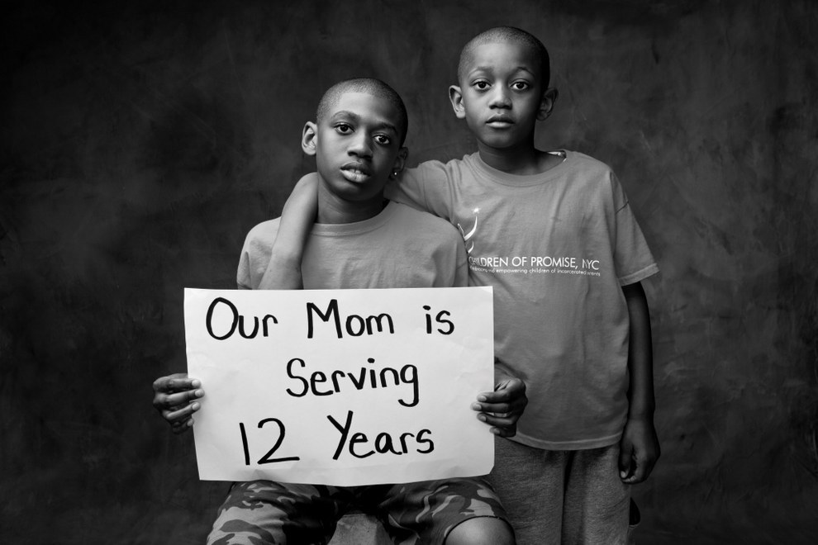
Older Children Whose Parents Serve Behind Bars
Department of Health said that children with parents in jail can struggle with poverty, poor grades, behavioral issues and depression
Kids grow up believing “their mother’s “home” is a place that society considers disgraceful → Leads to the child feeling “ashamed and rejected, angry and confused”
Child don’t understand why their mother is in jail and feel like it is that the mother doesn’t want to be with them
6x more likely to end up in jail if you have at least one parent who has been
Children more likely to lash out to authority figures - like police

Slide 7
Malik
“I got to visit my mom every week when she was gone to jail. My dad took us. It was hard because I wanted to touch her but she was on the other side of a glass wall. The visits weren’t too long, we only had a certain amount of time before they told us it was time to leave. When the visit was over, I wanted to stay with her for a long time. I thought about it all day. I didn’t cry but I felt really bad. It stayed with me for a while after I went.
“I didn’t tell my friends where my mom was, I told them she moved away. I could talk to my grandmother and my dad about it, but it was hard for them too. I missed my mom a lot, I missed watching movies with her, bike riding with her and I missed telling jokes.”

Slide 8
The Struggle to Stay in Contact
Sylvia Mignon and Paige Ransford looked into this
Many women never have the opportunity to reunite with children because of Child Services and the courts
They found that only 56% said that they had weekly contact with children, while 58% had never had a visit from their child/children
Keeping in contact is very beneficial to children AND mothers
Ease difficulty of separation
More responsible parenting
Children may form ideas about their mom that aren’t true so keeping in contact keeps an emotional bond that makes the child feel more protected and secure

Slide 9
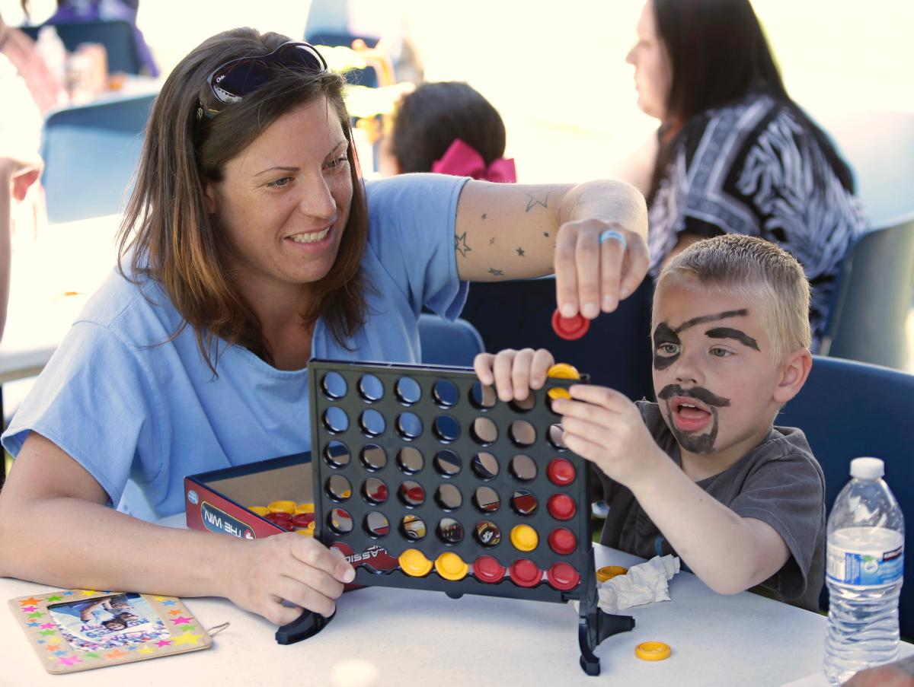
Mothers Day in Prison
“Get on the bus” Organization
Reunite mothers and children for free
In California
Video:
https://www.youtube.com/watch?v=TpNzfSgtwaI

Slide 10
What can be and is being done?
Corrections facilities can make it easier for mothers to be able to call their children
Offer psychological evaluations to mothers
CPS can bring the children to visit their parents more often
Bigger emphasis on programs that bring the mother and children together for visits
Organizations that aid children while their parents are in prison
Forever Family
SKIP, Inc.
Angel Tree Christmas

Slide 11
Sources
Baxter, Samuel C., & Palm, Sylvia L. Mothers in Prison: Another Crumbling Brick in the Family’s Foundation. Retrieved November 20, 2016, from https://realtruth.org/articles/080905-003-society.html
Bellware, Kim. "Putting Moms In Prison Punishes Their Kids, Too." The Huffington Post. May 9, 2016. Accessed November 18, 2016. http://www.huffingtonpost.com/entry/moms-in-prison_us_572f7808e4b096e9f091bff6.
Brown, Ely, and Alexa Valiente. "Babies Born, Raised Behind Bars May Keep Mothers From Returning to Prison." ABC News. February 7, 2014. Accessed November 22, 2016. http://abcnews.go.com/US/babies-born-raised-bars-mothers-returning-prison/story?id=22413184.
"Get On The Bus." Center for Restorative Justice Works. Accessed November 20, 2016. http://www.crjw.us/get-on-the-bus.
Glaze, Lauren E., and Laura M. Maruschak. "Bureau of Justice Statistics Special Report: Parents in Prison and Their Minor Children." Bureau of Justice. August 2008. Accessed November 22, 2016. http://www.bjs.gov/content/pub/pdf/pptmc.pdf.
Goshin, Lorie S. Behavior Problems and Competence in Preschoolers Who Spent Their First One to Eighteen Months in a Prison Nursery Program. PhD diss., Columbia University, 2010. 1-161. Accessed November 20, 2016. www.gradworks.umi.com/34/47/3447869.html.
I'm Raising My Baby in Prison - Anael's Story - Part 2 - Moms Behind Bars - Episode 2. YouTube. October 22, 2012. https://www.youtube.com/watch?v=sz_HvU5KUFA.
Mignon, Sylvia, and Paige Ransford. "Mothers in Prison: Maintaining Connections with Children." Social Work in Public Health 27, no. 1/2 (January 2012): 69-88. doi:10.1080/19371918.2012.630965.
"Prison Nurseries." Wikipedia. Accessed November 20, 2016. https://en.wikipedia.org/wiki/Prison_nursery.

Slide 12
Works Cited continued
Images
http://foreverfam.net
http://assets.nydailynews.com/polopoly_fs/1.1786395.1399670252!/img/httpImage/image.jpg_gen/derivatives/gallery_1200/children-reunite-mothers-folsom-women-facility-prison.jpg
http://media.gettyimages.com/photos/kay-weekley-touching-glass-separating-her-from-her-children-joe-picture-id50409164
https://s-media-cache-ak0.pinimg.com/736x/48/5a/cf/485acfc78bcb0c57debc0d251b15e32b.jpg
http://www.child-encyclopedia.com/sites/default/files/images/vignettes/aggression-aggressivity-360.jpg
https://img.buzzfeed.com/buzzfeed-static/static/2015-08/7/17/enhanced/webdr11/enhanced-buzz-wide-2279-1438984511-7.jpg
http://a.abcnews.com/images/US/ABC_prison_born_jtm_140207_16x9_992.jpg

