Slide 1
Theoretical Frameworks for Public Policy
This presentation adapted from “The Policy States Framework and Use at DOH” at https://depts.washington.edu/nopren/docs/Sitaker-NOPREN-112910.pptx .

Slide 2
Defining Issues and Problems
Who decides what an issue is or is not?
How can people get a problem on the national agenda?
Why does government address some problems and not others?
Can we be sure that a policy will resolve the problem?
Notes:
Are mass shootings a problem? What is the source? Is gun control an issue, or is it mental health?
Is police misconduct a problem? Is it a police problem or a Black folk problem?

Slide 3
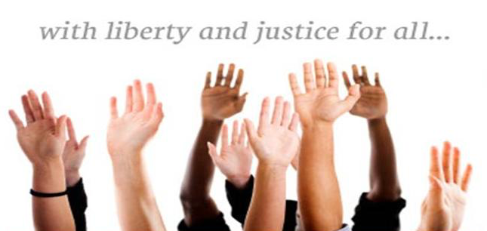
Does Public Policy Serve the Greater Good?

Slide 4
How to Identify Public Policy

Slide 5
AGENDA SETTING
IS THE PROBLEM A “SERIOUS” ONE?
CAN IT GET PAST THE “GATEKEEPERS”?
CONVERGENCE THESIS: TIME AND CONTEXT DETERMINE WHICH ISSUES MAKE IT ONTO THE NATIONAL AGENDA
ECONOMIC CYCLE THESIS: HARD TIMES FOCUS OUR ATTENTION ON LABOR AND EFFICIENCY, GOOD TIMES FOCUS OUR ATTENTION ON QUALITY OF LIFE AND WORKERS’ WAGES AND BENEFITS
ELECTORAL CYCLES-WHICH PARTY IS IN POWER AT ELECTION TIME?
POLICY MOOD: WHAT IDEAS ARE FLOATING IN THE ETHER?
Notes:
Who are the gatekeepers? Media, elected officials, interest groups, academics, all are “policy entrepenuers.”

Slide 6
Kingdon’s Three Process Streams
Problem stream involves persuading policy makers to pay attention to one problem over others (aka agenda-setting).
Policy proposals will rise to the top of the agenda when the associated problem is recognized as important. This depends on how it is framed or brought to policy maker’s attention (e.g., through data or focusing events).
Proposal stream is the process by which policy proposals are generated, debated, revised, and put forth for serious consideration.
More likely to be successful if perceived as technically feasible, compatible with policymaker’s values, reasonable in cost, and appealing to the public.
Politics stream refers to political factors that influence agendas, such as changes in elected officials, political climate or mood, and the voices of advocacy or opposition groups.
Notes:
This is the most robust theory of agenda-setting.

Slide 7
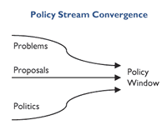
Coupling the Streams
The three streams have lives of their own
The probability of rising on the agenda is increased if all 3 streams are joined
Partial couplings between 2 streams are less likely to result in policy changes
Notes:
As such, no stream is decisive to the overall policy process, though all streams are important. It is precisely when all streams meet and coincide that an issue is transformed from a mere topic and/or problem into a concrete policy. What happens then is a compelling problem is linked to a plausible solution that meets the test of political feasibility
Kingdon argues that policy entrepreneurs play a key role in connecting the streams, and that there are different types of couplings.

Slide 8
Policy Entrepreneurs
Can be elected officials, career civil servants, lobbyists, academics, journalists
Entrepreneurs:
Highlight indicators of the problem to dramatize it
Push for one kind of problem definition over another – invite policymakers to see for themselves
Present specific policies as the solution to a problem on the agenda
“Soften up” by writing papers, giving testimony, holding hearings, getting press coverage, meeting endlessly…..
Entrepreneurs convince officials to see the problem the way they want it to be seen—and to use the solutions they propose.

Slide 9
Windows of Opportunity
Windows open when:
Problems “float” by that advocates can attach their policy solutions to
The political stream is advantageous
Windows don’t stay open long. Policy entrepreneurs can push their solutions when windows of opportunity open.
Make the critical couplings when policy windows open
Political connections and negotiating skills add to ability to move policy forward
Notes:
The major strength of this model is that it recognises that the policy process is fluid and non-linear, and that it involves a vast number of actors and forces

Slide 10
Processes for Changing Policies, Environments and Systems
Problem Identification
Clarify the problem & frame/ define it for Policy Agendas
Policy formulation
Conduct analyses to identify a solution to promote
Advocacy
Promote the solution to decision-makers
Implementation
Ensure that enacted changes becomes rule/processes/budgets
James Emery, MPH & Carolyn Crump, PhD
UNC School of Public Health
Evaluation
Evaluate the impact in terms of each process and overall goal

