Slide 1
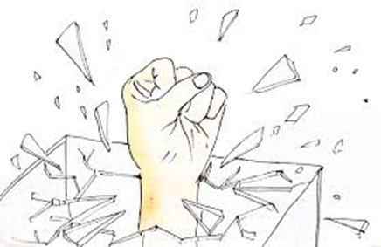
Research in Critical White Studies: Breaking the Concrete Ceiling
Dr. Eileen O’Brien (7/2018)
Professor of Sociology
Associate Chair of Social Sciences
eileen.obrien@saintleo.edu
www.dreileenobrien.org

Slide 2
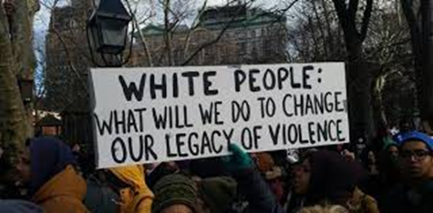
Today’s Objectives:
What is critical whiteness studies? How & why did it emerge? What is its purpose/goals? What do such researchers aim to accomplish?
Emphasize importance of research-based studies by providing examples of both primary and secondary research in my own work
Where do we go from here? Tips for whites (& all) working for racial justice

Slide 3
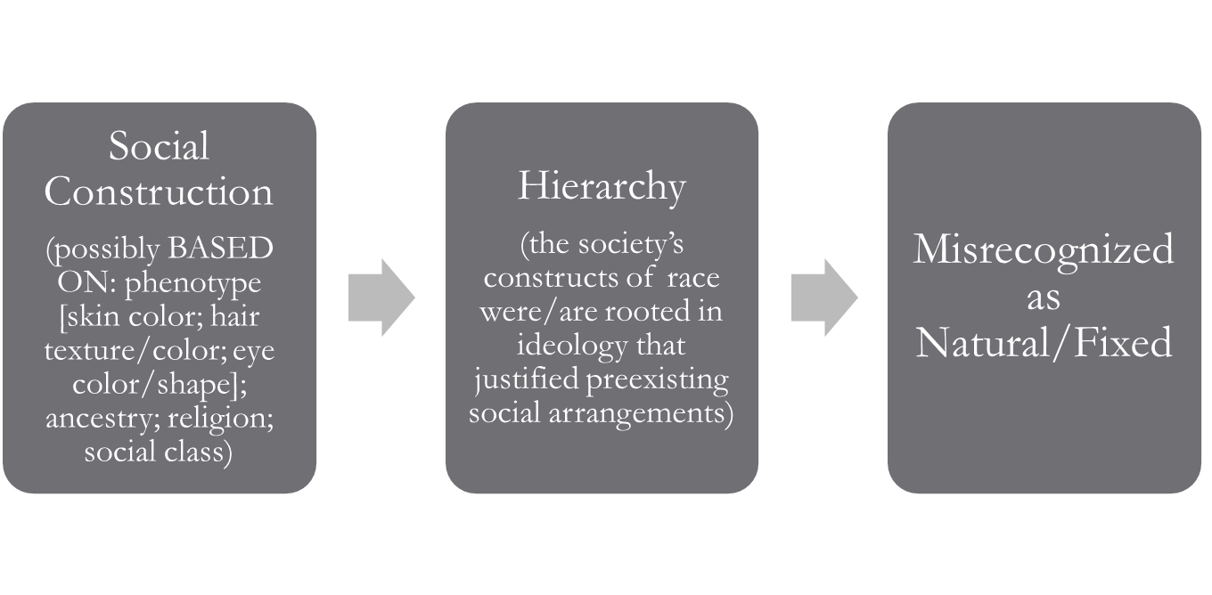
What is White? Did “whites” always exist? Who invented “race” & for what purpose?
Race is a relatively recent human invention (1800s), a pseudo-scientific category with social, political, economic, legal realities/consequences (cultural adaptations were later created around these legal separations)
According to biological science, there is only one race→ human (homo sapien)
Differences we see, we have been trained to see & are genetically superficial
Desmond & Emirbayer (2010) Racial Domination, Racial Progress;
Race: The Power of an Illusion (2000) PBS.

Slide 4
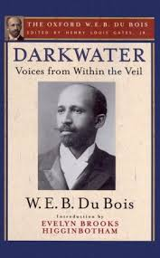
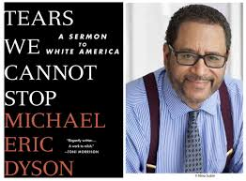
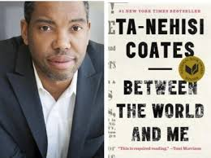
“White” invented to divide & conquer Whiteness is relational
W. E. B. DuBois (1920): Psychological Wage
Michael Eric Dyson (2017): “there is no such thing as white people. . . You don’t get whiteness from your genes. It’s a social inheritance. . . it’s killing us, and, quiet as it’s kept, it’s killing you too” (46) “When your ancestors got to America, they endured a profound makeover. . . All of your polkas, or pubs or pizzas, and more, got tossed into a crucible of race where European ethnicities got pulverized into whiteness.” (45) “never had to say they were white until someone not white showed up” (48) “Whiteness has only two modes: it either converts or destroys” (49)
Ta-Nehisi Coates (2015): “‘White America’ is a syndicate arrayed to protect its exclusive power to dominate and control our bodies. Sometimes this power is direct (lynching), and sometimes it is insidious (redlining). But however it appears, the power of domination and exclusion is central to the belief in being white, and without it, ‘white people’ would cease to exist for a want of reasons. There will surely always be people with straight hair and blue eyes, as there have been for all of history. But some of these straight-haired people with blue eyes have been ‘black,’ and this points to the great difference between their world and ours. We did not choose our fences. They were imposed on us. . .” (42)

Slide 5
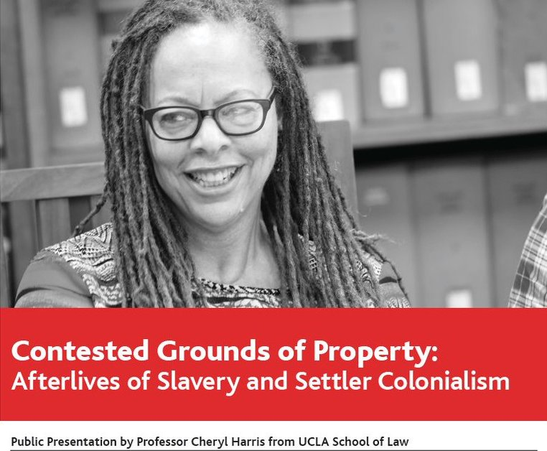
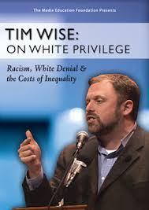
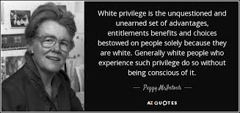
Why “whiteness studies?” Critical White Studies
Move from “minority studies” (e.g., women’s studies; ethnic studies) to also critically examining the majority group’s hegemony (defining the norms)
People of color, such as W.E.B. DuBois (“The Souls of White Folk”) and James Baldwin (“White Man’s Guilt” & “On Being White & Other Lies”) were writing about whiteness critically long before white scholars did so
Some now-essential readings include Peggy McIntosh’s “White Privilege,” Ruth Frankenberg’s White Women, Race Matters, Cheryl Harris’s “Whiteness as Property,” Tim Wise’s White Like Me, Melanie Bush Breaking the Code of Good Intentions
Video clips: McIntosh (1:41) Tim Wise (1:42)

Slide 6
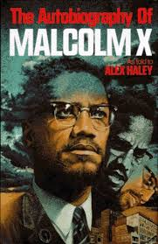
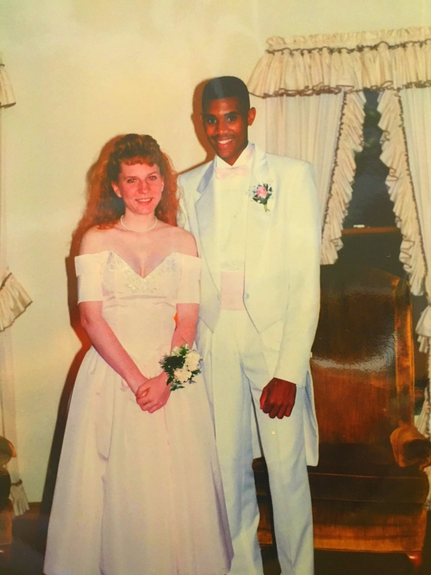
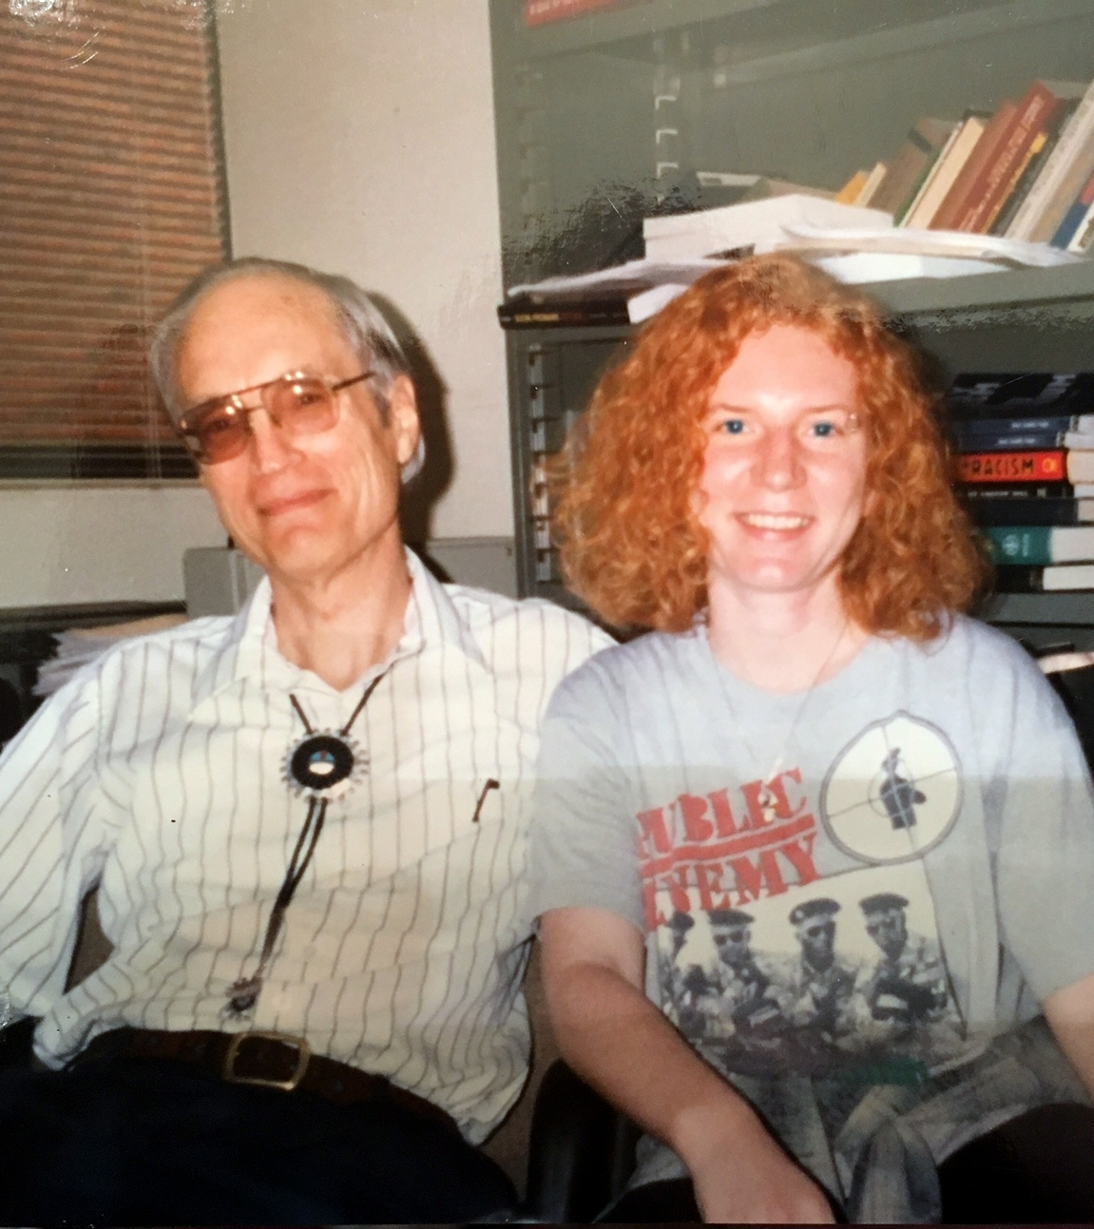
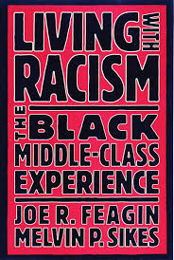
My own journey: Becoming a Racism Researcher
Studying race and racism→ traditional model= studying non-whites
Mentor (Joe Feagin) suggests: “you have a lot of insights into how whites reproduce racism”
Dissertation topic switches from coping strategies African Americans use when facing racism to white antiracist activists (a.k.a. white allies)
Tim Wise on white allies (3:24)

Slide 7
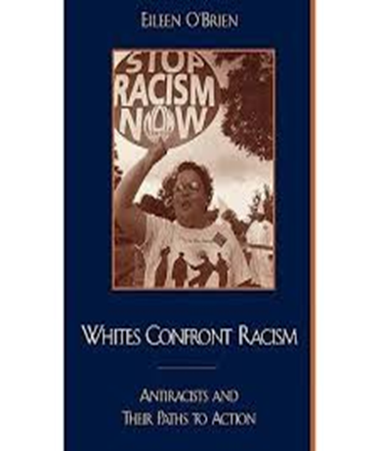
Whites Confront Racism: White Antiracists & Their Paths to Action (2001)
Primary data: collected interviews with 30 white antiracist activists and 5 activists of color; also participant-observation with 2 antiracist organizations (Anti-Racist Action [ARA] and People’s Institute for Survival & Beyond)
Main questions: (1) What motivates whites to become antiracist? (2) What do they do? (individual & institutional level) (3) what challenges do they face?
Key findings:
(1) Variety of motivators: Relationships with people of color; Religious commitment to social action/justice; Other forms of oppression; Other forms of activism
(2) Individual strategies ranged along a continuum--varied with the setting & relationship to the perpetrator; Institutional strategies varied by organization
(3) Challenges: maintaining relationships with other whites; developing and maintaining trust with people of color

Slide 8
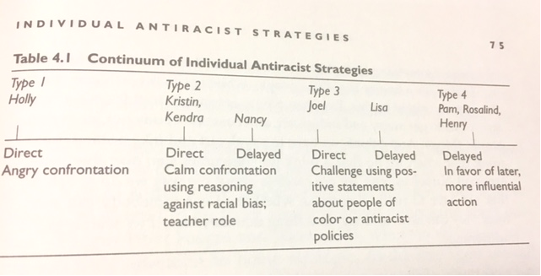
Example Findings:
Strategies
Challenges
Take a moment: IMAGINE
Anti-Racist Action (ARA): example program = “Copwatch” → the racists are “out there” and need to be challenged (“we go where they go”)
People’s Institute for Survival & Beyond: example program = “Undoing Racism” workshop → racism is in us, in our own organizations (“exploit the gate” for “gatekeepers”)
Maintaining relationships with other whites (Mike, p. 113; Nancy, p. 114)
Dyson: Thanksgiving Dinner (3:19)
Establishing credibility/trust with people of color
Obstacle = “False Empathy” (Delgado) (Jason, p. 120; Jessica)
Goal = Accountability & Humility (Pam p. 121; David p. 124; Kendra p. 124-5)
Searles: Gem Droppin’ From White Savior to Ally (4min)

Slide 9
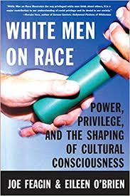
White Men on Race: Power, Privilege & the Shaping of Cultural Consciousness (with Joe Feagin, 2003)
Primary data: collected interviews with 100 “elite white men” (personal incomes of over $100K in 2000; powerful positions of influence)
Main questions: (1) What are the major beliefs and experiences these men have about race, and how aligned are they with reality? (2) When they are in positions to influence race-related situations (which is often, especially in hiring), what do they do and why?
Key Findings:
Their interactions with nonwhites are limited. They get their info either from TV news, or from non-equal-status contact (i.e., coworkers they supervise-- & from other research, we know this kind of contact is superficial, at best). They have a lot of misinformation and misperceptions about people of color which they hold with much certainty. They have the power to influence others based on these misinformed positions.
When asked about situations of racism, most chose not to speak out or intervene, even if they did not agree, because they did not want to damage their relationships with these other whites.

Slide 10
Example Findings
Misinformation + Authority
Low Intervention: Not a racist but….
“No religious background, no family background” (p. 108)
“No sense of family” (p. 109)
“Less motivated in the workplace” (p. 110)
Don’t “try as hard” (p. 111-112)
“I wouldn’t be able to fire him” (p. 160-1)
“When the time is right, I’ll say something, but there is no rush” (p. 160)
“I’m not sure if I would want to embarrass that person publicly” (p. 162-3)
“Everybody would have felt uncomfortable (p. 163)
“Nothing you can do about it” (p. 164)
“Too much to drink” (p. 165)
Protecting Whiteness

Slide 11
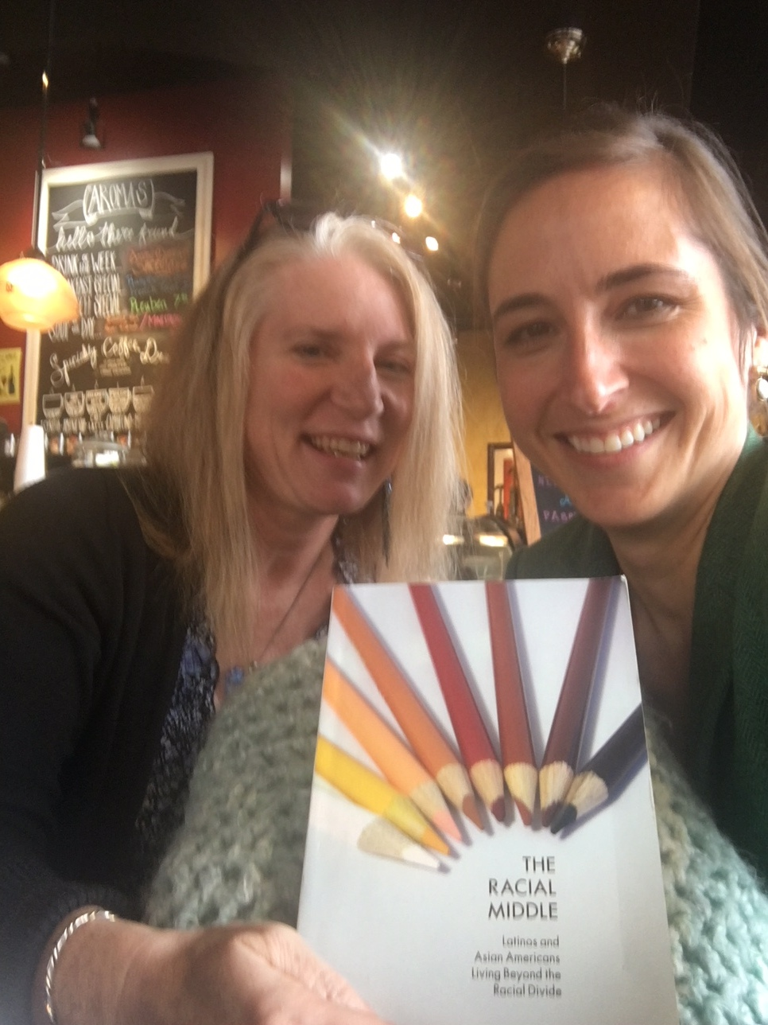
The Racial Middle: Latinos & Asian Americans Living Beyond the Racial Divide (2008)
Primary data: 50 interviews with Latino (23) and Asian (27) Americans
Main questions: Are Latinos and Asian Americans “becoming white” like Jewish and Irish Americans did before them? Or are they part of a “collective black” (Bonilla-Silva) experience where they continue to be treated as nonwhites, not fully equal?
Key Findings: Data did not fully fit either “either/or” path above. Plenty of evidence of being treated not fully equal, but cannot be equated to a collective black experience. They get better treatment/more accepted than blacks in some cases– a uniquely “middle” experience.

Slide 12
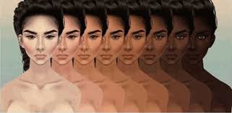
Example Findings
Antiblack Racism→
Route to Honorary Whiteness?
No racism, except for that one time…
Peter, Mexican American (p. 66): distancing self from blacks as a route to whiteness
Heather, Filipino American (p. 110): parents encourage dating Asian & white over Black & Hispanic
Christopher, Honduran-Dominican American (p. 120): “abanzando la raza”
Caitlin, Puerto-Rican American (p. 177): could pass as white but prefers to identify with collective black & challenge racism
Jon, Filipino American, (p. 184): finds common ground with African Americans once leaving for college
Charlene, Thai-Filipino American (p. 170) “I didn’t even see you”
Where are you from?/what are you? (Charlene, p. 130; Edita, Guatemalan American, p. 131)
Minimization: Cuban American siblings Monica (p. 141-2) and Joe (p. 142-3); Kali, Indian American (p. 149 & 156)
“Not complaining” may be dangled as a path to whiteness, but at what cost?

Slide 13
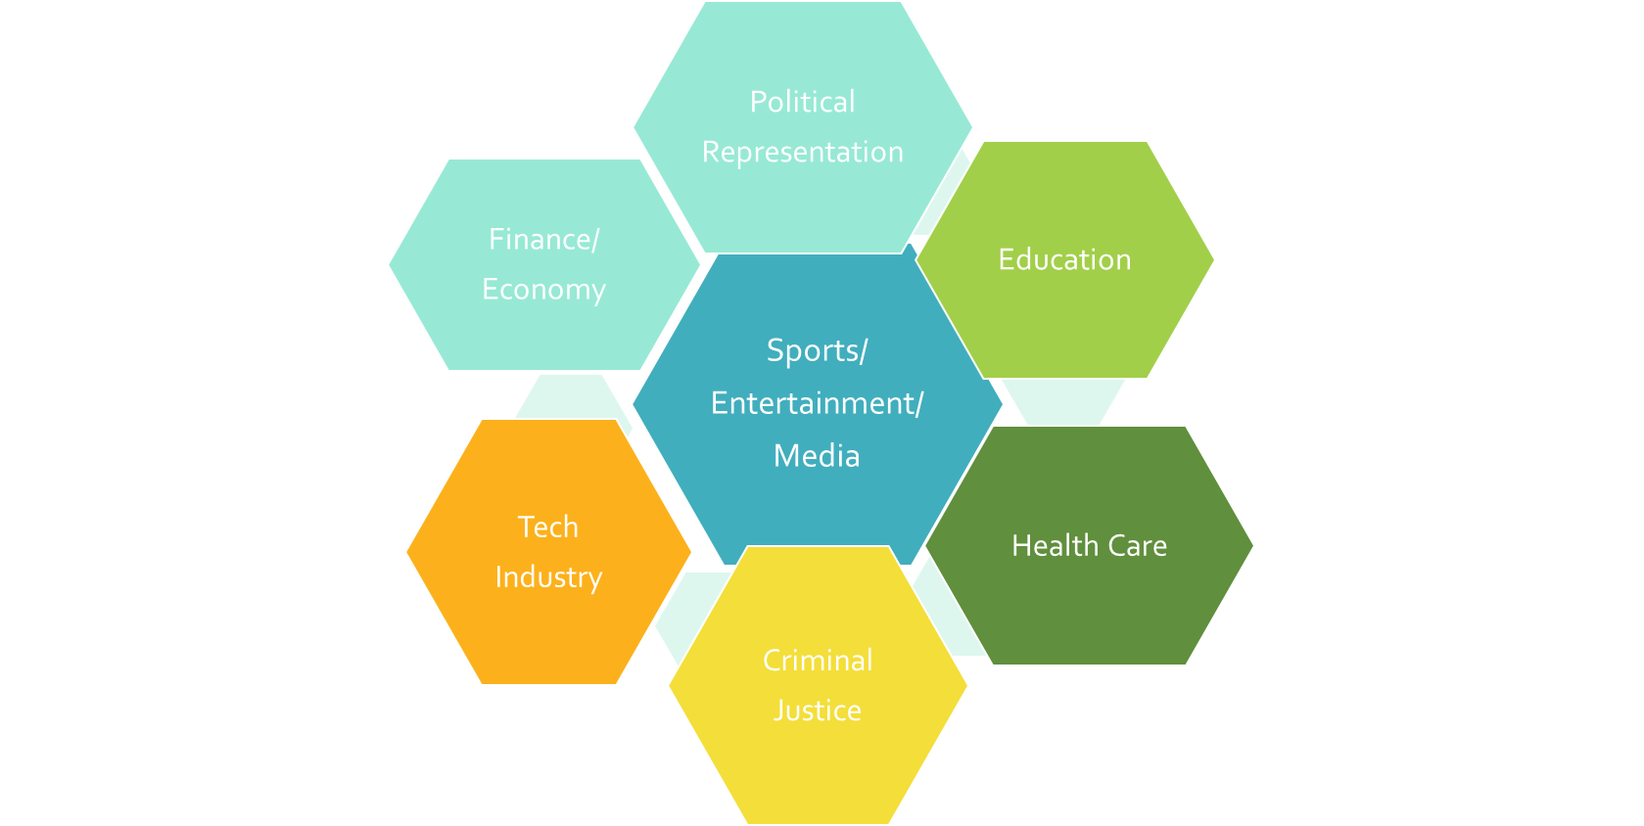
White Privilege: Studying Racism by Naming the Unnamed With Dr. Ninochka “Nosh” McTaggart Forthcoming, 2019, Cognella Press
Chapter 1: Race: What Is It? Who Decides?
Chapter 2: Prejudice, Discrimination & Racism
Chapter 3: The Microaggression-to-Institutional Racism Pipeline:
Racism Across Several Key Social Institutions
Economy
Education
Criminal Justice
Chapter 4: Culture and Media Representation
Chapter 5: Antiracism/Breaking the Concrete Ceiling
Moving away from the “prejudice problematic”;
Beyond bigots & bad apples…

Slide 14
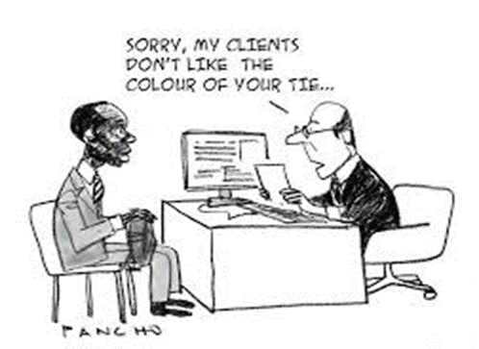
Prejudice Yes No
External Influences
on Individual Behavior
Prejudiced Discriminator (“All-Weather Bigot”) | Unprejudiced Discriminator (“Fair Weather Liberal”)
Prejudiced Non-discriminator (“Timid Bigot”) | Unprejudiced Non-Discriminator (“All Weather Liberal”)
Yes
Discrimination
No
Notes:
The yellow boxes are the areas where people’s “intention” is not the same as the outcome. In other words, racism does not always come from bigots. We cannot equate the two. Peer pressure situations (examples given in talk) cause non-bigots to discriminate to fit in. Bigots don’t always discriminate if they stand to gain by keeping quiet. It’s much more complicated than just educating folks out of their bigotry.

Slide 15
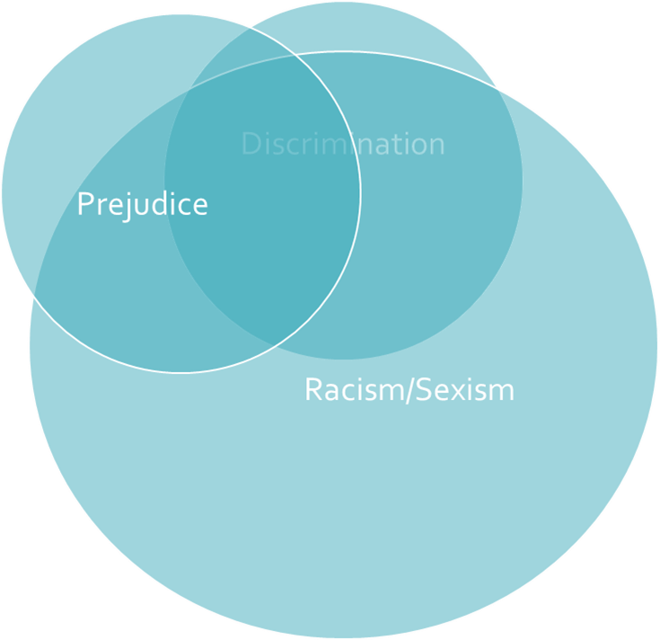
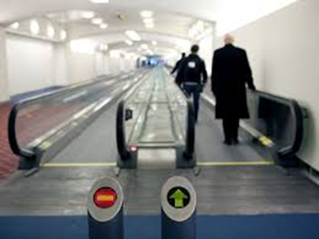
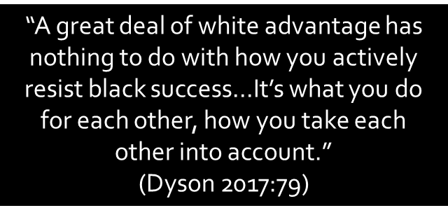
Prejudice/Discrimination vs. Racism/Sexism
system that advantages/privileges
the dominant/majority group in society
Notes:
Two examples: (1) Grocery store clerk not asking for ID when a white person writes a check. It’s not “discrimination” that would hold up in a court of law. The policy is to ask for ID, so in asking the next black person in line for ID, she is covered by policy. Advantages/privileges with a smile. (2) Realtors steering customers to neighborhoods where they’d “be more comfortable.” Not telling them they can’t see other places. Both cases, trying to be friendly/helpful… Tatum defines racism as that moving walkway at the airport—even when you’re not walking with it/accelerating it, just standing on it, it flows in direction of majority privilege; antiracism is actively walking against the flow

Slide 16
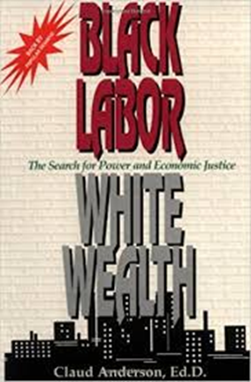
White/Male Privilege Examples
Sports
Film/TV
2017 NFL:
Players are 70% Black. Of 32 teams:
Black owners = 0
Black head coaches = 7 (22%)
CEO/Presidents women OR people of color = 0
Black quarterbacks = 8 (25%)
2017 NBA:
Players are 74.4% black. Of 32 teams:
Black owners = 1
Other nonwhite owners = 2
CEO/President (Black = 4; Women = 6)
Black head coaches = 6 (19%)
Music
-Women accounted for just 17 percent of all the directors, executive producers, producers, writers, cinematographers, and editors who worked on the top-grossing 250 domestic films of 2016.17
-Women were just 26 percent of all off-screen talent on broadcast networks, cable, and streaming programs during the 2015-16 season.
-Only 5 Black men have ever been Oscar nominated for Best Director (no Black women); none have won.
-Only 1 woman has ever won an Oscar for Best Director
-Among top paid film actors, women get 30 cents to a man’s dollar. There is a $42 million gap between the highest paid actor & the highest paid actress.
-On the top-paid list (of 20), there are no women of color, 1 black man, 1 Asian man & 2 multiracial.
-Only 3 Black women have ever won Grammy for album of the year
Women have only been 9.3% of all Grammy nominations in past five years
In the past three decades, only 7 out of 30 acts that have won album of the year were black
Women make up only 30% of senior executive roles despite making up more than half of entry-level positions
Sources: Lapchick, Richard. 2017. “The 2017 Racial & Gender Report Card: NFL” and “The 2017 Racial & Gender Report Card: NBA” http://www.tidesport.org/reports.html ; Vilanova, John. 2017. “Beyonce’s Grammy Snub & The Glass Ceiling on Black Art.” LA Times (February 13); Johnston, Maura. 2018. “What Do the Grammys Have Against Women?” Rolling Stone (January 29); Gibsone, Harriet. 2017. “Pop’s glass ceiling: why new female stars can’t break through.” The Guardian (July 21); Allen, Matthew. 2018. “Should Black Artists Care About the Grammys?” The Root (January 30).; Warner & Corley 2017 (ibid); Elkins, Kathleen. 2017. “The 20 highest-paid actors in the world include 2 Ryans, 2 Toms and only 3 women.” CNBC (December 7). Hill, Libby. 2018. “Jordan Peele joins elite class of black men nominated for director — and could make history.” LA Times (January 23).

Slide 17
Prejudice points fingers at “bias”; Racism widens our lens to the “unintentional”
Prejudice
Intentional
Racism/
Sexism
Impact/effect (rather than intent)
Individual
Exclusionary
Societal/systemic (rather than individual-blaming)
Advantage/privilege (focus is on the “benefit of the doubt” dominant group gets, rather than intentional exclusion of others)
Key Terms:
Opportunity Hoarding
Homosocial Reproduction

Slide 18
Effect/End Outcome is the Same!
“Donald”
“Harvey”
Family and friendship network is all-white
Interests & activities in racially segregated environments (e.g., golf, private country clubs)
Has been caught saying racist & sexually derogatory remarks
New TV show uses all the white male writers, directors & producers he’s worked with before because he’s familiar with them
Has diverse friends & interests
Collects art from many countries, people of all colors & backgrounds adorn his walls
Supports & contributes to feminist causes
New movie uses mostly white male writer, director, producers because they have more experience & he knows their work will be high quality from previously working with them
What’s the Bottom Line?

Slide 19
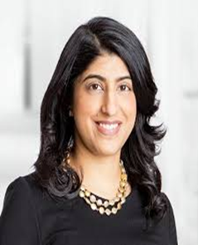
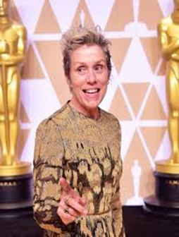
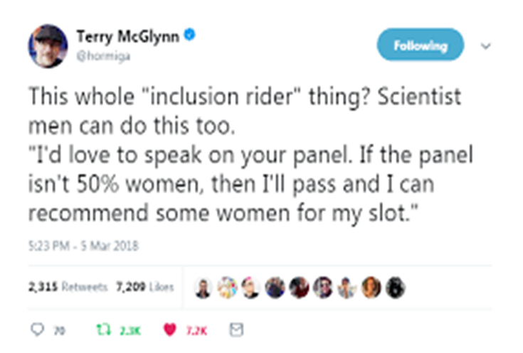
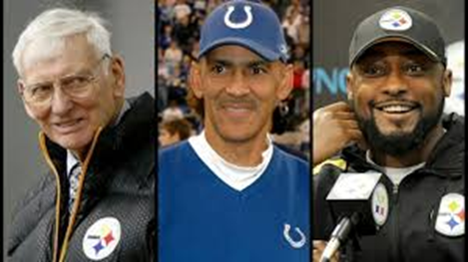
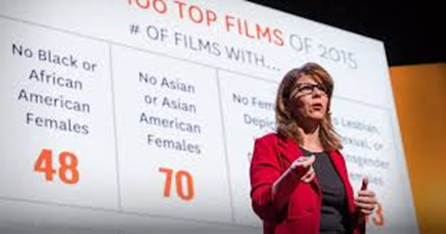
Where do we go from here? How to break the concrete ceiling
Industry example solutions:
Rooney Rule
Inclusion Rider
Personal practices?

Slide 20
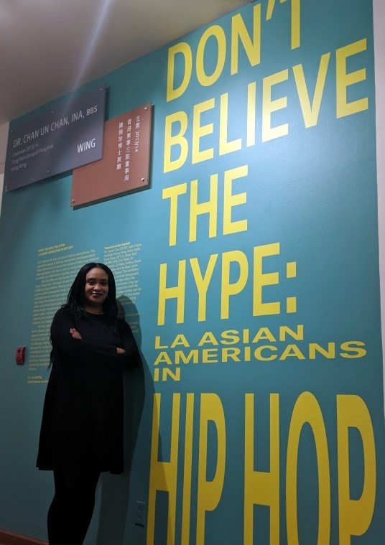
Thoughts? Questions? Comments?
“Just because women and members of racial/ethnic minorities are being shown on the screen, it does not mean they are not being cast in stereotypical roles. This is why it is necessary to dig deeper and analyze what types of roles are being given to women and racial minorities.”
“…it is also essential to explore who is represented behind the camera as well …. It is important to tell a diversity of stories to get a more accurate picture of what our society really looks like.”
Dr. Ninochka “Nosh” McTaggart
eileen.obrien@saintleo.edu
www.dreileenobrien.org
Twitter: @Eileen_OBrien_
“Racial equity is realized when race can no longer be used to predict life outcomes, and outcomes of all groups are improved.”
whitesforracialequity.org

